Slide 1

Isogeny-Based Cryptography
A talk by Krystal Maughan
Notes:
[1]
Hi, thanks for coming to my isogeny-based cryptography talk today. My name is Krystal Maughan and this summer I worked on a project related to explainability at JP Morgan AI Research. However, when I go back to school, my dissertation work will be related to isogenies.

Slide 2
Agenda
What is an elliptic curve?
What is an isogeny?
How do we find isogenies?
Crypto: What can we make with Isogenies?
SIDH, CSIDH and SIKE
SIDH in the news
Post-quantum cryptography
Current work in evaluating the Robustness of Isogenies-Based Cryptography
Timeline and Future Work
Notes:
[2]
So for today’s talk, I’m roughly going to talk about elliptic curves, which are the starting point to talk about isogenies, then how we find isogenies, and the elements we need to make crypto with them. I’ll about SIKE, SIDH and CSIDH and some of the recent news about SIDH, as well as post-quantum cryptography and my current project.

Slide 3

Who am I?
Current PhD student at the University of Vermont
Working between Computer Science and Pure Maths departments
Image from pixbay.com
Notes:
[3]
So briefly, who am I? I’m a current PhD student at the University of Vermont working between Computer Science and Pure Mathematics. I took a mathematical cryptography course with my now advisor, and after enjoying the course immensely, we decided that we should collaborate on research.

Slide 4
Elliptic Curves
Notes:
[4]
So let’s start with elliptic curves. What is an elliptic curve?

Slide 5


Definition Elliptic Curves
Definition: Elliptic curves are curves of genus one having a specified base point. Every such curve can be written as the locus in of a cubic equation with only one point, the base point, on the line at . Then, after X and Y are scaled appropriately, an elliptic curve has an equation of the form that can be expressed as a Weierstrass equation:
Silverman, J., 1986, “The Arithmetic of Elliptic Curves”
Notes:
[5]
Elliptic curves are curves of genus one having a specified base point. Each such curve can be written as a local in P^2 of a cubic equation with only one point, the base point, on the line at infinity. Then, after X and Y are scaled appropriately, an elliptic curve has an equation of the form that can be expressed as a Weierstrass equation.

Slide 6
Typical Elliptic Curve equation
We go from an elliptic curve of this form:
To this form:
Silverman, J., 1986, “The Arithmetic of Elliptic Curves”
Notes:
[6]
So we go from this elliptic curve form to its Weierstrass form of the equation giving a cubic equation.

Slide 7
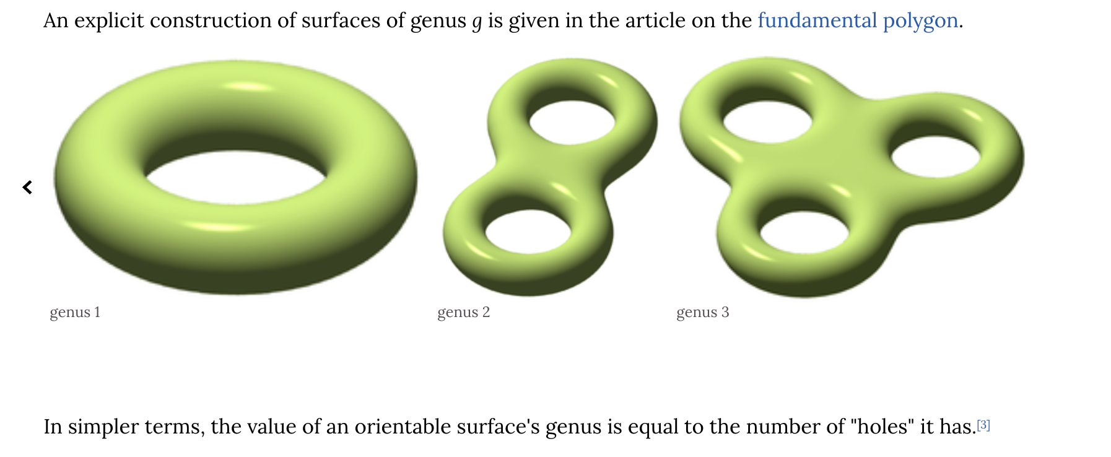
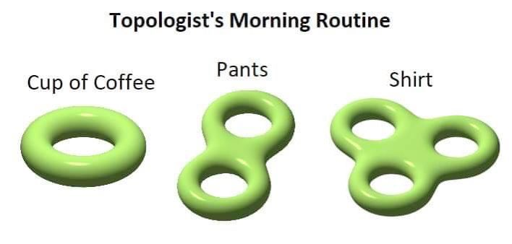
Genus: “number of holes in a surface”
https://www.wikiwand.com/en/Genus_(mathematics)
This is just a Maths meme
Notes:
[7]
And then when we say, genus one, we want to think of a genus as a representation of the number of holes in a surface. And this has to do with the connectedness in topology or cuts on a closed surface. So a genus one would look like this, genus 2, this, and genus 3.

Slide 8
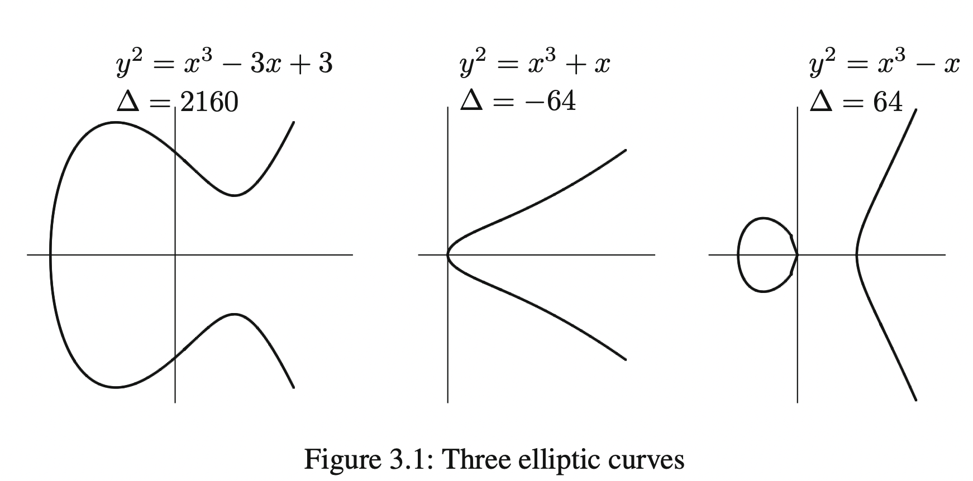
Base point
Base point : usually at infinity. In this case, O = [0, 1, 0], which is a point at infinity (we expect that this part of the curve is parallel to the Y axis and goes to infinity).
These points actually go to infinity.
Silverman, J., 1986, “The Arithmetic of Elliptic Curves”
Notes:
[8]
And a base point is usually at infinity. So when we look at an elliptic curve, we usually have a point say O = [0,1,0] which means that the curve is parallel to the Y axis which is usually a characteristic of these curves. When we draw elliptic curves, there is usually a part of the curve with points that go towards infinity.

Slide 9
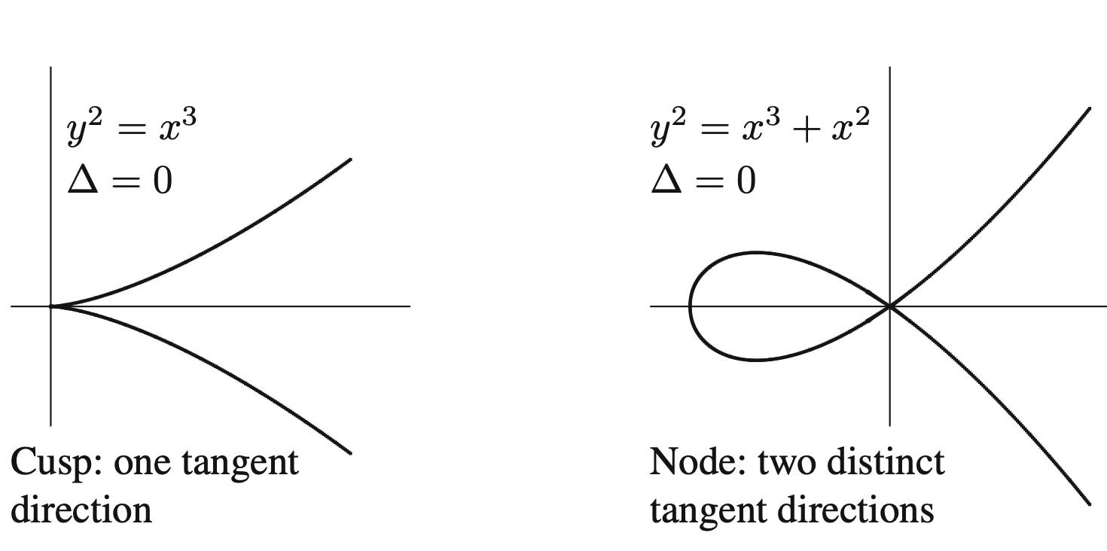
Types of Elliptic Curves
Nodes vs Cusp
Silverman, J., 1986, “The Arithmetic of Elliptic Curves”
Notes:
[9]
There are also generally these two types of elliptic curves that are commonly seen; a cusp, which has one tangent and a node, which has two.

Slide 10
Why Elliptic Curves
Similar security guarantees to other traditional methods, but with fewer bits.
Uses algebraic structure of elliptic curve over finite fields and gives smaller keys (based on Galois Fields) compared to equivalent security.
Translates to less power consumption, increase in speed in cryptographic systems
Siegel, J. “Elliptic Curve Encryption”, http://www.umsl.edu/~siegelj/information_theory/projects/EllipticCurveEncyiption.pdf
Notes:
[10]
But why did we even start caring about elliptic curves for cryptography? Elliptic curve cryptography has similar security guarantees compared to other traditional methods, but it uses fewer bits.
It uses the algebraic structure of the elliptic curve over finite fields and gives smaller keys based on Galois Fields. And this affects power consumption and the speed of cryptographic systems.

Slide 11
Some Protocols that use Elliptic Curve Cryptography
ECDH (Elliptic Curve Diffie-Hellman)
ECIES (Elliptic Curve Augmented Encryption Scheme)
ECDSA (Elliptic Curve Digital Signature Algorithm)
EdDSA (Edwards-curve Digital Signature Algorithm (based on Schnorr signature and twisted Edwards curve)
Notes:
[11]
So some of the protocols that use EC are listed here such as ECDH (Elliptic Curve Diffie-Hellman) and EdDSA, which is the Edwards-curve Digital Signature Algorithm which is based on Schnorr signature and twisted Edwards curve).

Slide 12

Elliptic Curve Cryptography
Disclaimer: Elliptic curves are already a well-researched area of cryptography. Elliptic curve cryptography generally relates to the Discrete Log Problem and there are well-known attacks on elliptic curves.
This talk is not about that.
Notes:
[12]
But we’re not going to talk about elliptic curve cryptography today. Elliptic curve cryptography is already a well-research area of cryptography and it generally relates to the Discrete Log Problem and there are well-known attacks specifically on elliptic curve cryptographic protocols.

Slide 13
So why Isogenies? Computational Hardness / Complexity
Notes:
[13]
So why isogenies. Part of this has to do with the hardness properties of isogeny-based solutions

Slide 14
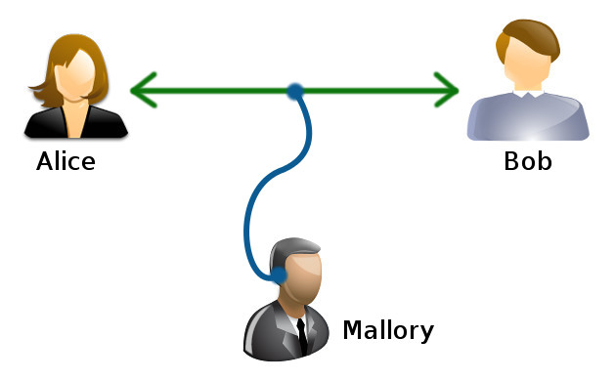
Encryption is necessary
Everyday use: used for browser connections, Email Authentication
Diffie Hellman key exchange (DH)
Verify Bob, decrypt message
Attacker should be able to learn nothing (frequency analysis, information theoretic) about the message
Encryption and decryption must not be too “easy” to crack
Wikimedia Commons, “Alice and Bob”
Notes:
[14]
We use encryption every day, whether it is to connect a browser or for email authentication. The classic example used for encryption is called Diffie Hellman key exchange; when two persons (shown as Alice and Bob here) would like to send a message to each other without a third being able to listen in and decrypt their message. This third person called Mallory in this diagram, must not learn anything about the message and the decryption process must not be too easy so that Mallory can intercept the message.

Slide 15
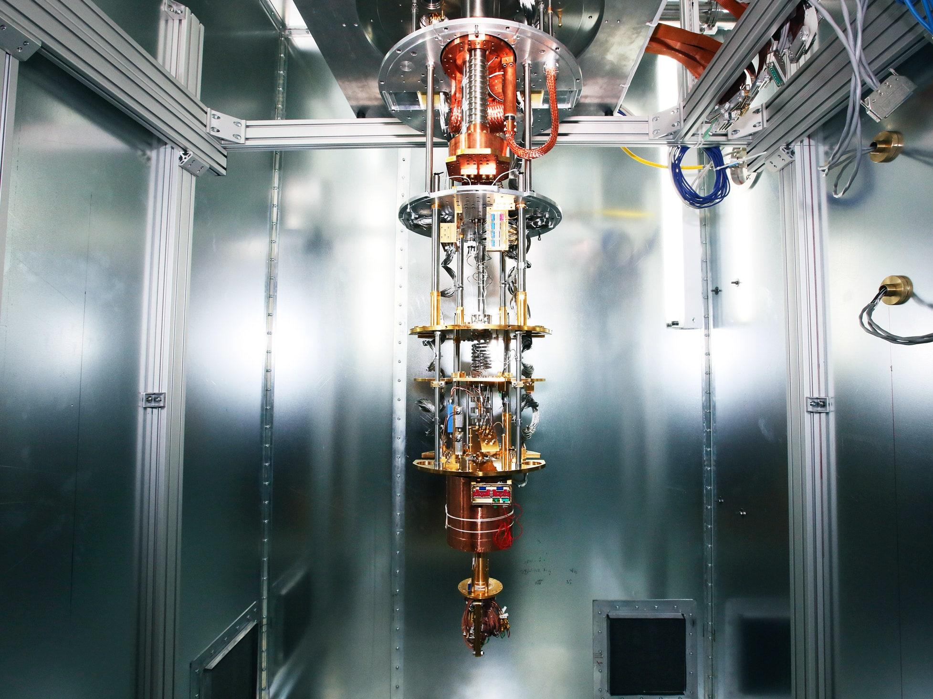
Challenge: Quantum Computers
2030: quantum computers
Companies already investing or have quantum computers. Will our future include personal quantum computers?
(top right) Wired: Google’s Quantum Supremacy Isn’t the end of encryption, 2021 showing that 200 seconds to perform a task a supercomputer would take 100,000 years to perform
Notes:
[15]
The challenge today is that quantum computing provides a significant threat to our classical methods of encryption. Companies such as Google, Microsoft, and IBM are already investing billions of dollars into quantum computing. We can even begin to think that in the future, we may even have personal quantum computers in our homes. This photo on the right shows Google’s Quantum computer, which is able to perform a task that a supercomputer takes 100,000 years to perform in just 200 seconds.

Slide 16

Implications of encryption broken by quantum computers
Fast solution to previously hard problem
Threats to personal security
Threats to national security
(above) Stock Hacker Image, Getty Images
Notes:
[16]
So what does this mean if quantum computers can perform tasks faster? Well, since decryption is based on the hardness of encryption, it means that quantum computers could break our current classical methods of encryption. And the implications of this are threats to national security and to our personal security.

Slide 17
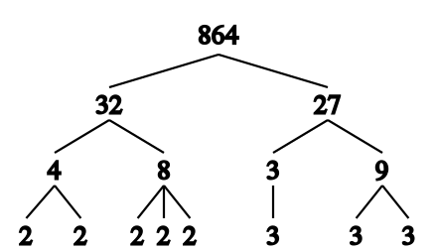
How encryption works
Public-Key Cryptography: relies on problems that are easy to solve but difficult to reverse engineer. If:
P = 34,141
Q = 81,749
P * Q = 2,790,992,609
Complexity of computation can make it impractically long for a computer to factorize into its component primes.
(above) Wikipedia commons: Integer Factorization for Prime decomposition where n=864
Notes:
[17]
And this is because the way encryption classically works is that it relies on problems that are easy to solve but difficult to reverse engineer. So think about Alice and Bob knowing with a key how to unlock the message, but Mallory having difficulty reverse engineering to find the key value and therefore decrypt the message. This is because encryption uses integer factorization to make complexity of computation impractically long for a computer to factorize into its component primes.

Slide 18
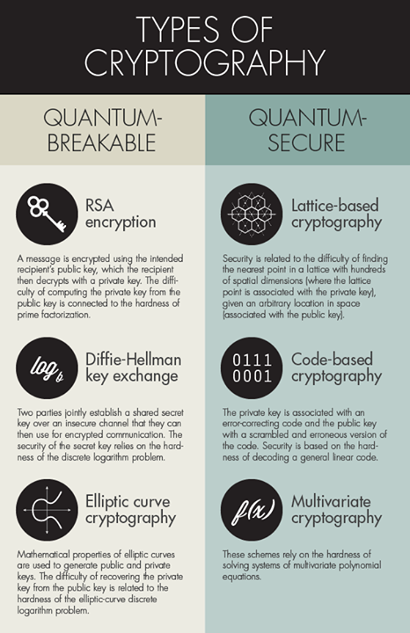
Discrete Log Problem
Much encryption today relies on the Discrete Log Problem (DLP)
A quantum computer can solve these problems substantially faster, rendering them insecure.
(left) Shmahalo, O., Quanta Magazine, “Quantum Secure Cryptography Crosses Red Line”, 2015
Notes:
[18]
Another difficult problem is called the Discrete Log Problem, or DLP. A quantum computer can solve these problems substantially faster, rendering classical encryption systems insecure. On the left, we see a chart from 2015 in which Quanta Magazine identified quantum breakable and quantum secure cryptography encryption.

Slide 19
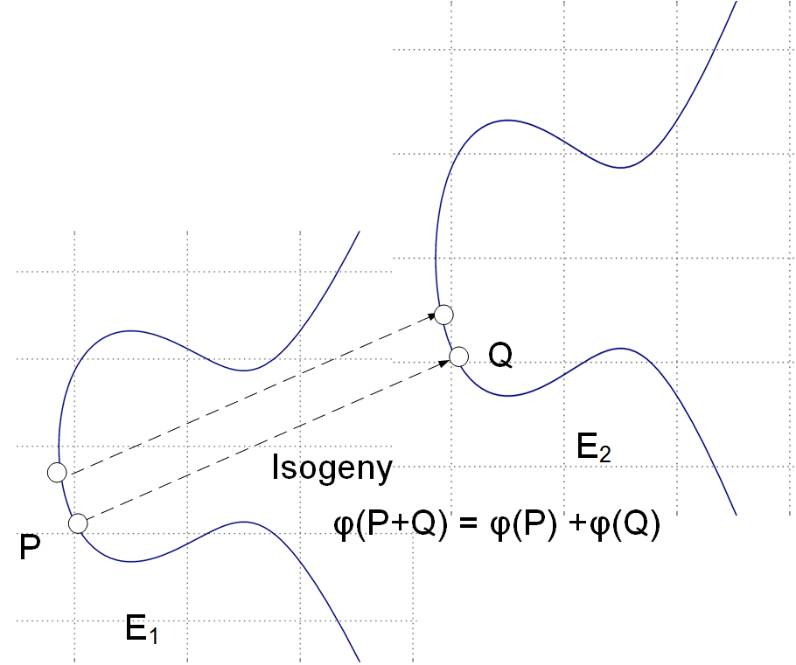
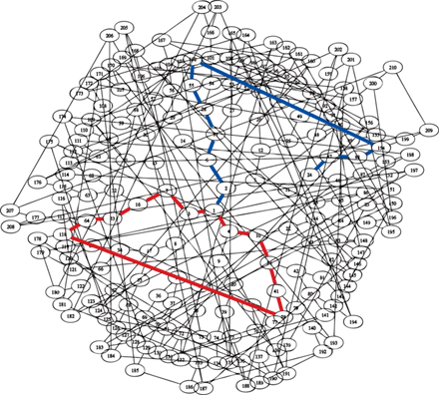
Isogenies generate Random-Looking Graphs
Based on Ramanujan properties on the graph
Hard to invert graph
Expander constant: if you take a subset of the graph and look at its neighbours the number of new neighbours is proportional to a constant x the size of the subset of the graph
Elliptic Curve Pairing
(above):“Prof Bill Buchanan: “Supersingular Isogeny Diffie-Hellman (SIDH)”
(above) Photo courtesy of Isogeny Summer School/ Supersingular Isogeny Graph of p=2521, courtesy of Charles-Goren-Lauter, Science Magazine, “Hash of the Future?” by Dana Mackenzie, Science 14 Mar 2008 Vol 3 Issue 5869 pp 1481
Notes:
[19]
Isogenies are a promising new type of encryption that start from an elliptic curve pairing of a type supersingular to generate a large random expander graph with Ramanujan properties. These properties make a walk along a path appear random to an onlooker, and make this particular type of encryption, isogeny based encryption, quantum-safe.

Slide 20
Isogenies: What are they and how we find them?
Notes:
[20]
So how do we even build isogenies, and how do we find them?

Slide 21

How are Isogenies made?
From elliptic curve pairings
There are really two of us! We are special!
Notes:
[21]
We can start by saying that isogenies are elliptic curve pairings, and they are made from very special elliptic-curve pairings

Slide 22

Starting: Supersingular vs non-supersingular
Doesn’t mean “singular” (in E.C.) sense (all E.C.s are nonsingular or the discrete logarithm would be easier to compute and break crypto), but more so peculiar or “superspecial”. If we have a finite field F with p elements, a supersingular elliptic curve is one E/F with the property that the endomorphism ring (which is the ring of homomorphisms from E to E) of E over the algebraic closure of has (unusually large) rank 4 as a module of Z (according to Hasse, 1936).
Notes:
[22]
These are supersingular elliptic curves, and supersingular is distinct from singular curves in general elliptic curve definitions, in the sense that all elliptic curves are nonsingular, because this ensures that the discrete logarithm problem is difficult to solve. Instead, they are supersingular, which we can blackbox as meaning superspecial. And this means that if we have a finite field F with p elements, a supersingular ellipitic curve is one E/F with the property that the endomorphism ring (which is the ring of homomorphisms from E to E) of E over the algebraic closure of F_p has (unusually large) rank of 4 as a module of Z (and this is what Hasse observed in 1936).

Slide 23
Elkies: Supersingular
Elkies proved that supersingular primes (which are defined such that for every elliptic curve E/Q, it is a prime p such that if E has good supersingular reduction at p), these supersingular primes are infinite in number.
Notes:
[23]
Let’s talk about their rarity: Elkies proved that supersingular primes (which are defined such that for every elliptic curve E/Q, it is a prime p such that if E has good supersingular reduction at p, these supersingular primes are infinite in number.

Slide 24
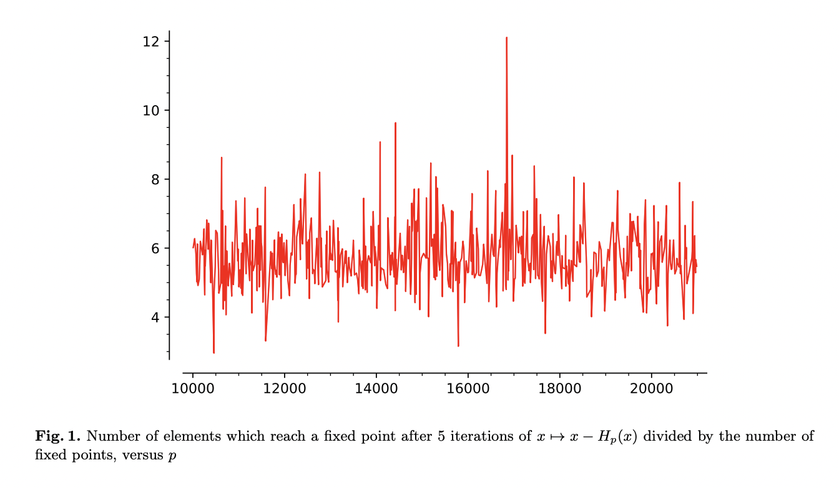
Finding a supersingular curve is hard
Fig 1., Booher J. et al, 2022, “Failing to hash into supersingular isogeny graphs”
Notes:
[24]
But finding a supersingular curve is hard.

Slide 25

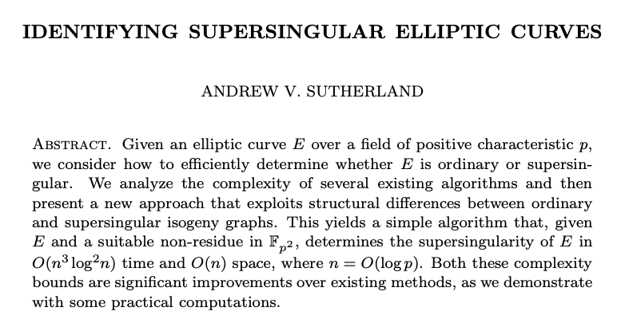

Finding a supersingular elliptic curve
Has to satisfy:
Having p-torsion subgroup E[p] that is trivial.
J-invariant j(E)
#
Sutherland A., “Identifying Supersingular Elliptic Curves”, 2016
Notes:
[25] So much so that Sutherland, in 2016, wrote a paper about it.

Slide 26


Schoof’s Algorithm
Finding supersingular elliptic curves is rare. Schoof’s algorithm identifies supersingular curves in time. This can be improved to time using Bröker’s Method.
Notes:
[26]
Anyways, Schoof’s algorithm can be used to find supersingular elliptic curves. It can identify these in O(log^5p) time. This can be improved to O(log^4p) using Broker’s method.

Slide 27
Bröker’s Method
The first isogeny cryptosystem was proposed by Couveignes in 1997. We can use Bröker’s Method to construct a supersingular elliptic curve E/
A Sutherland, “Computation in supersingular isogenies”, 2018, CTNT
Notes:
[27]
The first isogeny cryptosystem was proposed by Couveignes in 1997. We can use Bröker’s Method to construct a supersingular elliptic curve E/F_p.

Slide 28




Vélu’s Formula
Given an elliptic curve E/k and a point of order there is a separable isogeny : of degree n, unique up to isomorphism. We can compute this value, which is the isogeny , using Vélu’s formula.
A Sutherland, “Computation in supersingular isogenies”, 2018, CTNT
Notes:
[28]
And we can prove bijection by using Velu’s formula. So given an elliptic curve E/K and a point P in E(k) of order n, there is a separable isogeny of degree n, that can be computed using this Velu’s formula.

Slide 29
Kernel of Isogeny
An isogeny is a surjective morphism that is also a group homomorphism. For separable isogenies, the order of the kernel give us its degree. Furthermore, every isogeny can be decomposed into the composition of a separable isogeny and a power of the p-power Frobenius morphism (which has a trivial kernel).
A Sutherland, “Computation in supersingular isogenies”, 2018, CTNT
Notes:
[29]
The isogeny is a surjective morphism that is also a group homomorphism, so for separable isogenies, the order of the kernel of the isogeny gives us its degree. Furthermore, each isogeny can be decomposed into the composition of a separable isogeny and a power of the p-power Frobenius morphism (which has a trivial kernel). And as our definition by Sutherland gave us earlier on, this should confirm that we have a supersingular elliptic curve isogeny.

Slide 30


We need our elliptic curves pairings to be isomorphic
According to our Weierstrass equation, we need our elliptic curves to be nonsingular (so their , where is the discriminant of the Weierstrass equation, and j is the j-invariant of the elliptic curve).
We also note that two elliptic curves are isomorphic over K-bar iff they both have the same j-invariant.
Silverman, A, “The Arithmetic of Elliptic Curves”, pg. 45
Notes:
[30]
We need our elliptic curve pairings to be isomorphic. So according to our Weierstrass cubic equation, we need
our elliptic curves to be nonsingular (so Delta is 0, where Delta is the discriminant of the Weierstrass
Equation, and j is the j-invariant of the elliptic equation) and we need them to be isomorphic over K bar so that
we can show that that they have the same j-invariant.

Slide 31
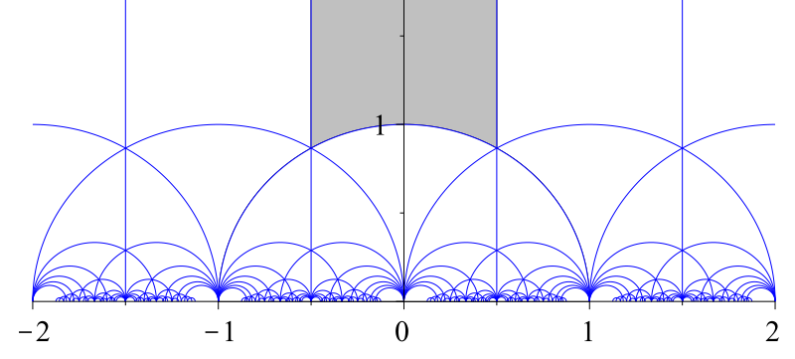
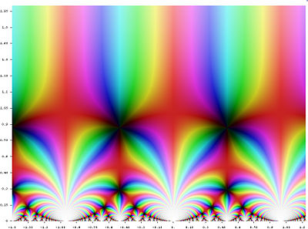
J-invariant: what it looks like
The Modular Discriminant (delta): As defined by the fundamental domain of the modular group acting on the upper half plane -Wiki
Notes:
[31]
Lastly, we need the j-invariant. This is what the j-invariant looks like, and it involves the Modular discriminant, delta, which is defined by the fundamental domain of the modular group acting on the upper half plane.

Slide 32


j-invariant
A Modular function is defined on the upper half-plane such that we can parameterize our elliptic curves over the complex numbers.
Given an elliptic curve E/Q written in the Weierstrass form:
We usually define the j-invariant:
Notes:
[32]
So a j-invariant specifically is defined on the upper half-plane such that we can parameterize our elliptic curves over the complex numbers. So given an elliptic curve E/Q written in Weierstrass form, we can derive the j-invariant according to this formula.

Slide 33
j-invariant
Our j-invariant is defined by a field of characteristic K that is of 2 or 3 because 1728 is divisible only by 2 prime numbers: 2 or 3. Typically, if is the denominator of the expression so if is 0, j is undefined or infinity.
Notes:
[33]
And we define our j-invariant by the field of the characteristic k sa being 2 or 3 because 1728 is divisible only by 2 prime numbers; 2 or 3. And typically, if Delta is the denominator of the expression such that delta is 0, j would become undefined or infinity in our expression.

Slide 34
Why do we need the j-invariant
It helps us to classify certain homomorphic properties of our elliptic curves which we will use in cryptographic schemes / to make isogeny assumptions.
Notes:
[34]
So the j-invariant also allows us to classify certain homomorphic properties of our elliptic curves which we will use in our cryptographic schemes to make our isogeny assumptions.

Slide 35
High-level ways we make Isogenies
Notes:
[35]
So how do we put together these things to make isogenies?

Slide 36

Pairing Groups: Projective map between genus 1
Surjective
Finite kernel
Group homomorphism
An elliptic curve is usually defined by a short Weierstrass equation
“Prof Bill Buchanan: “Supersingular Isogeny Diffie-Hellman (SIDH)”: https://medium.com/coinmonks/supersingular-isogeny-diffie-hellman-sidh-for-post-quantum-computer-key-generation-6742d2ea78dc,
Notes:
[36]
A pairing group that makes an isogeny is defined as a projective map between genus 1, from E to E’. It has to be surjective, have a finite kernel, is a group homomorphism, and has this elliptic curve defined by a short Weierstrass equation.

Slide 37




Dual-isogenies
Gives us a homomorphism in the opposite direction. Let
be a nonconstant isogeny of degree m. There exists a unique isogeny satisfying :
Notes:
[37]
The concept of dual isogenies means that we have a homomorphism going in the opposite direction. So if we let phi be E_1 which maps to E_2, and that is a nonconstant isogeny of degree me, there exists a unique isogeny phi_prime that is E_2 to E_1 satisfying this rule.

Slide 38
Dual-isogenies
This gives us properties of the kernel of the multiplication-by-m map and tells us that [m] is a finite separable map.
Notes:
[38]
So this rule gives us the properties of the kernel of the multiplication by m map so it tells us that this [m] isa finite separable map.

Slide 39
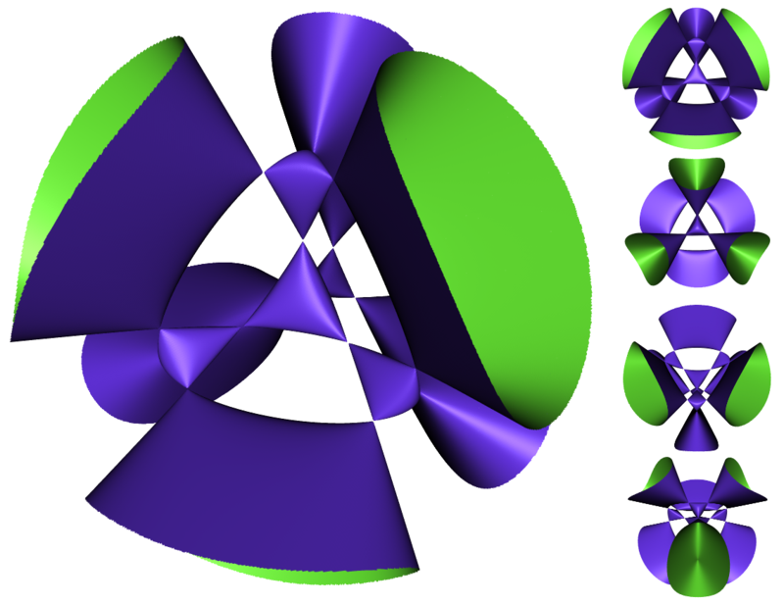
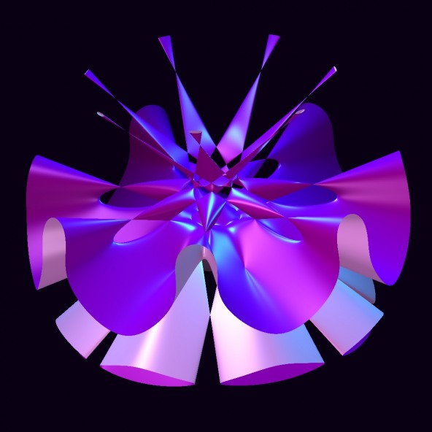
Higher Genus Isogenies (beyond scope of talk)
Above genus 1: We can also use these to form isogenies and get something called the Weil pairing.
Notes:
[39]
I want to note that although we have been talking about elliptic curves and genus 1, that there is work being done on hyperelliptic curves of higher genus. These are Kummer surfaces, and there are isogenies that can be created using these surfaces, using something called the Weil Pairing, but Kummer spaces and hyperelliptic curves are beyond the scope of this talk.

Slide 40

Weil pairing
Let E/K be an elliptic curve. We fix an integer m 2, which is prime such that p = char(K) if p > 0.
We get a Weil pairing that has surjectivity.
Notes:
[40]
But Weil pairings, generally, will help us show surjectivity. So if we let E/K be an elliptic curve, we can fix an integer m which is greater than or equal to 1, which is a prime such that p = characteristic (K) if p is more than 0.

Slide 41
Weil pairing
Allows us to compute the degree of an isogeny, and to show surjectivity using the Tate module. This will help us later on.
Notes:
[41]
And this constraint allows us to compute the degree of an isogeny, and to show surjectivity using something called the Tate module.

Slide 42
Bag of useful things we’re going to use for cryptography
Elliptic curve-pairing
Supersingular curves
Genus 1
Use Velu’s Formula to find an isogenies
Degree of isogeny
Kernel of isogeny
J-invariant
Bag of
Isogenies goodies
Surjectivity
Satisfiability of algebraic group-constraints
Notes:
[42]
So we now have a bag of things that help us make isogenies goodies. How do we make cryptography with these things? What does that begin to look like?

Slide 43
Cryptography with Isogenies
Notes:
[43]
So now on to cryptography with isogenies

Slide 44

Method for sampling supersingular elliptic curve over
We start by computing an isogeny between two elliptic curves over the same finite field
This is the supersingular isogeny problem.
Hardness is such that it is supposedly quantum-safe.
Notes:
[44]
So we can start by computing an isogeny between two elliptic curves over the same finite field F_p^2. This is the supersingular isogeny problem and hardness is such that this is supposedly quantum safe.

Slide 45
Hard supersingular curves
We need to not reveal the endomorphism ring or have a method whereby computing the endomorphism ring is as difficult as it is for random supersingular curves. How do we do this and why is it important?
Notes:
[45]
When we do this process, we need to not reveal the endomorphism ring or have a method whereby computing the endomorphism ring is as difficult as it is for random supersingular curves. And we do this because this is where we need a lot of security constraints

Slide 46

Security provided by Not knowing endomorphism ring
Without a trusted setup, we can have backdoors or torsion point attacks.
Retsu, Baku, Getty Images
Notes:
[46]
If we know the starting endomorphism ring, we can open up our setup to have backdoors or torsion point attacks.

Slide 47

L-isogeny path problem
We have elliptic curves E, E’ / related by an isogeny of l-power degree, and we want to compute l-isogenies along a path.
Notes:
[47]
So often when we have isogeny protocols, we want to have an initial endomorphism ring and this L-isogeny path, where we take elliptic curves that are related by an isogeny of lth power degree and we compute l-isogenies along a path.

Slide 48
Deuring correspondence
The Deuring Correspondence gives us a bijection between supersingular elliptic curves (over ) .
Notes:
[48]
And we use the Deuring correspondence to give us a bijection between supersingular elliptic curves over F_p

Slide 49
SIKE
(supersingular isogeny key encapsulation)
Notes:
[49]
So let’s look at SIKE

Slide 50
SIKE
Is an isogeny-based key encapsulation suite based on pseudo-random walks in supersingular isogeny graphs. It is in stage 4 of the NIST standardization process on post-quantum cryptography.
Notes:
[50]
SIKE is an isogeny-based key capsulation suite based on pseudo-random walks in supersingular isogeny graphs. It is in stage 4 of the NIST standardization process on post-quantum cryptography.

Slide 51
SIKE
SIKE is made of:
A CPA- secure public key encryption algorithm called SIKE.PKE
A CCA-secure key encapsulation mechanism, SIKE.KEM
Notes:
[51]
It is made up of two parts: a PKE or public key encryption called SIKE.PKE and a secure encapsulation mechanism called SIKE.KEM

Slide 52
Quantum Computers and NIST
Notes:
[52]
So what does this mean?

Slide 53
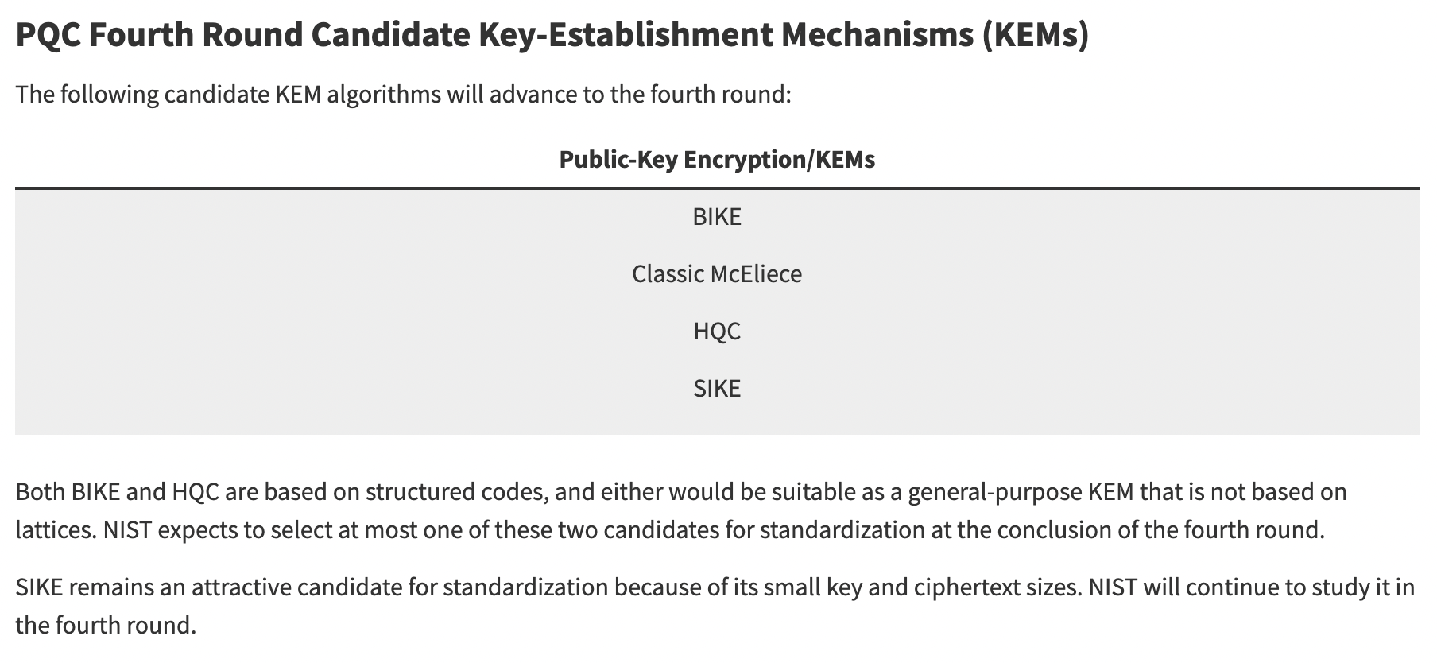
4th round: SIKE
NIST, “PQC Standardization Process: Announcing Four Candidates to be Standardized, Plus Fourth Round Candidates”, July 5th, 2022
Notes:
[53]
It’s currently in the 4th round of the Post Quantum Standardization process as of July 5th 2022, when NIST announced the round 4 candidates. With this in mind, it is always being improved and modified because we want these protocols to be secure.

Slide 54
Isogeny key encapsulation with a Diffie-Hellman implementation
Notes:
[54]
So the next isogenies related topic is an implementation of Diffie Hellman called SIDH.

Slide 55
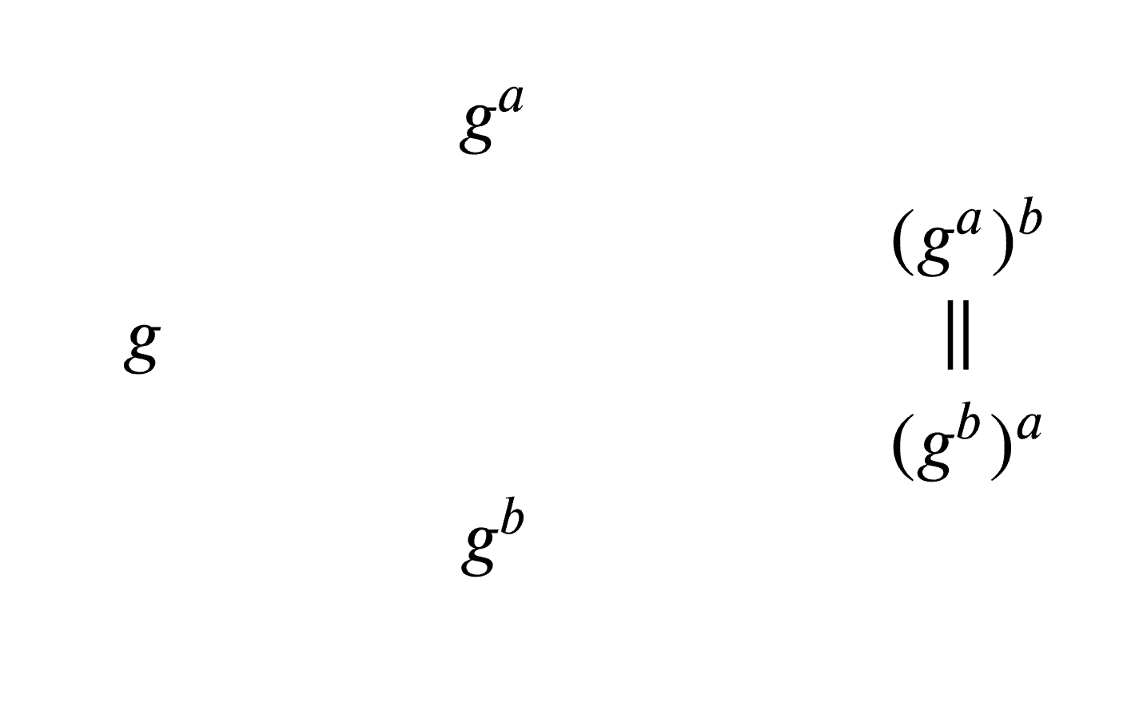
Diffie Hellman (classic)
Notes:
[55] So in the traditional Diffie Hellman Key Exchange model, Alice picks a secret integer that she doesn’t reveal to anyone and so does Bob; let’s call these a and b. And then Alice sends to Bob the computed value of this function g^a (mod p) where p and g are public knowledge, and Bob sends to Alice the computed value of the function g^b (mod p). And we can represent this with a commutative diagram, where they get to share their common value or shared key g^ab or g^ba.

Slide 56
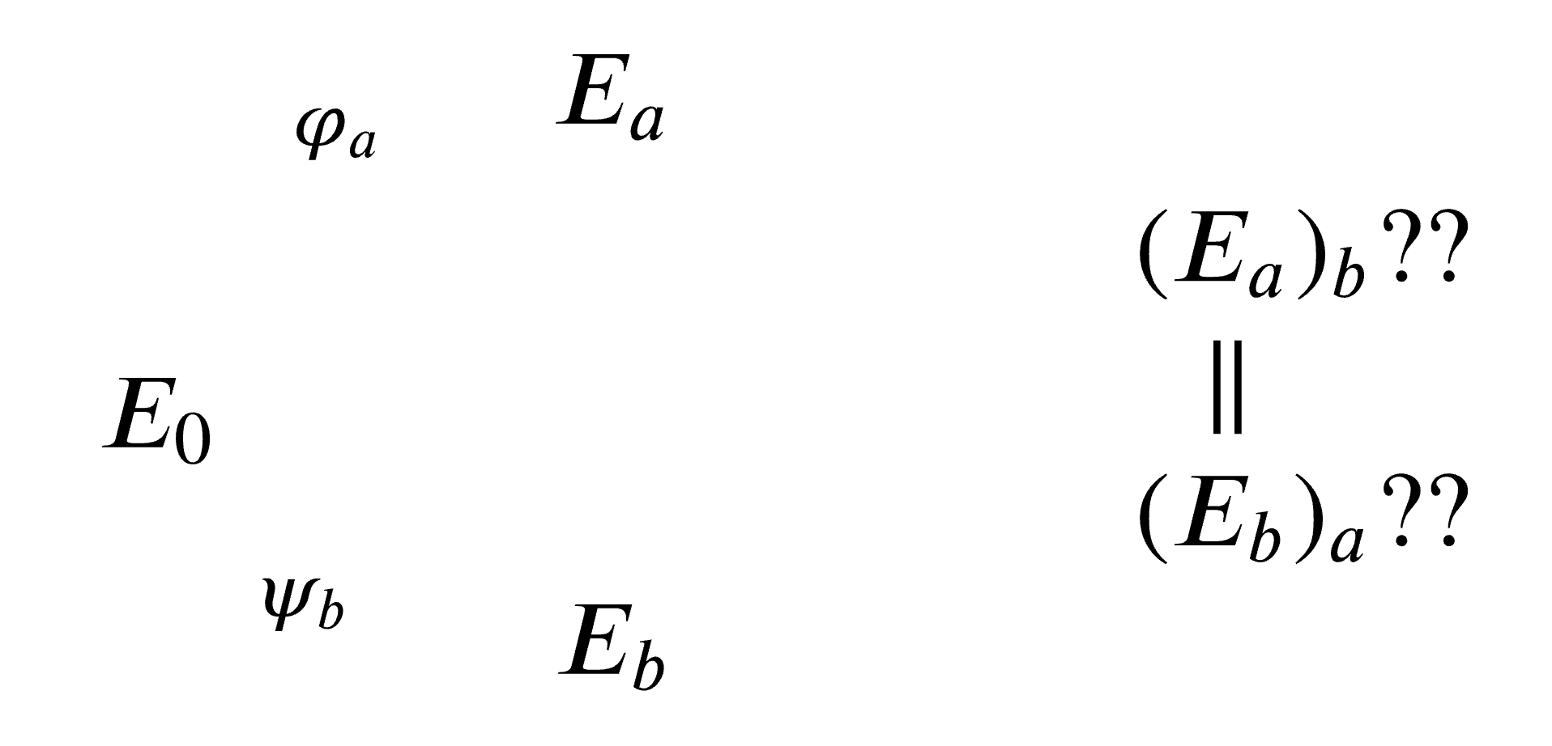
Diffie Hellman (Isogenies)
Notes:
[56]
So let’s try to do with this isogenies. We look at two elliptic curves, and try to do this with E_a and E_b in the same way, but we can’t directly. This just won’t commute.

Slide 57
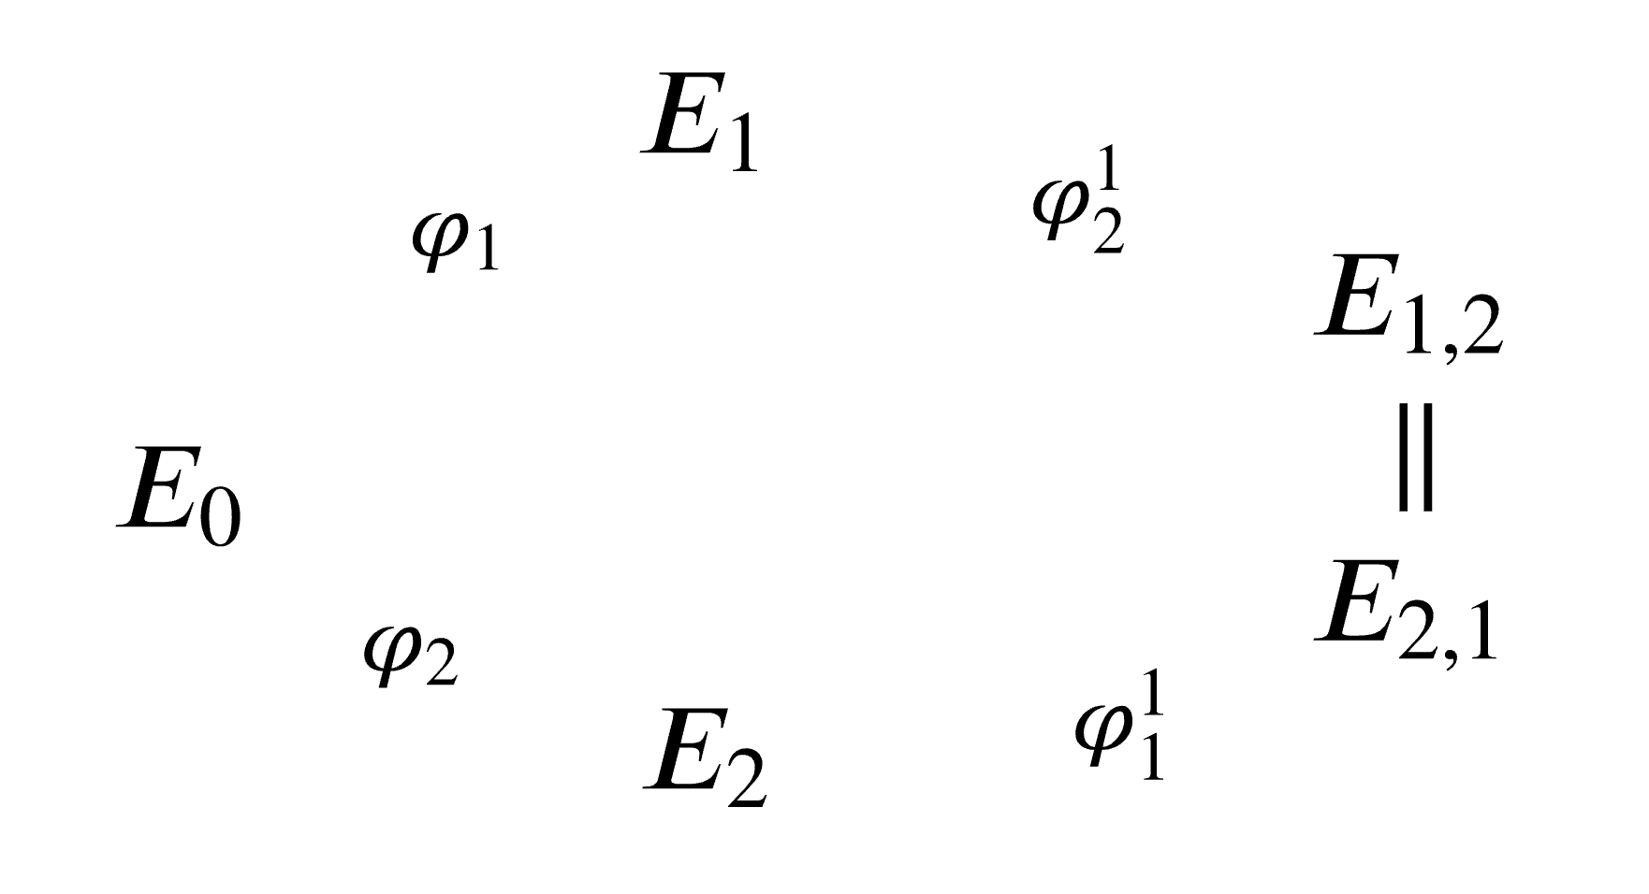
Diffie Hellman (Isogenies)
Notes:
[57]
What we have to do instead is compute isogenies, which are labelled Phi_1 and Phi_2, which are the isogenies that can be initially generated by this supersingular elliptic curve over a field. By computing the corresponding isogeny (say, Phi_1) and the image curve (E1), what Alice has to do is compute the corresponding Isogeny Phi_1 and the image curve E_1 as well as Phi_1 (P2) and Phi_1 (Q2) which are the basis of torsions on E0. She then sends E_1, Phi_1 (P_2) and Phi_1 (Q2) to Bob.

Slide 58
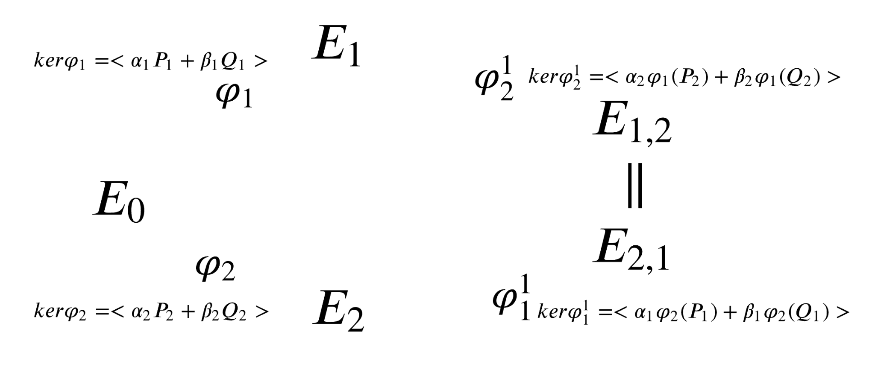
Diffie Hellman (Isogenies)
J 1,2
J 2,1
Notes:
[58]
So Alice computes a corresponding isogeny upon receiving a corresponding P and Q from Bob and he does his calculations and then they can look at their corresponding isogenies Phi^1_1 and Phi^1_2, their image curves and their j-invariants and the shared secret. What makes our diagram commute is the j-invariant, which is j_12 for Alice and j_21 for Bob and this is the shared key or our equivalent of g^ab.

Slide 59
SIDH
Starting point: “is a form of post-quantum Diffie-Hellman key agreement with a non-abelian structure using isogenies”**
Supports four parameter sets: SIKEp434, SIKEp503, SIKEp610,
SIKEp751
SIDH: Supersingular Isogeny Diffie-Hellman.
**Cryptography Stack Exchange, “What’s the difference between SIDH and SIKE?”, 2020, user: forest
Notes:
[59]
So SIDH is a form of post-quantum Diffie Hellman key agreement with a non-abelian structure using isogenies. It supports four parameter sets and stands for Supersingular Diffie Hellman.

Slide 60
CSIDH
Commutativity using two-power and three-power isogeny group and torsion points. Uses Ideals (a and b); they commute
Notes:
[60]
CSIDH uses this similar concept of commutativity using two-power and three-power isogeny groups and torsion points. It uses ideas (A and B) to commute.

Slide 61
Robustness of Isogeny-Based Cryptography
Notes:
[61]
Now I”m going to talk about the robustness of Isogeny-based cryptography.

Slide 62
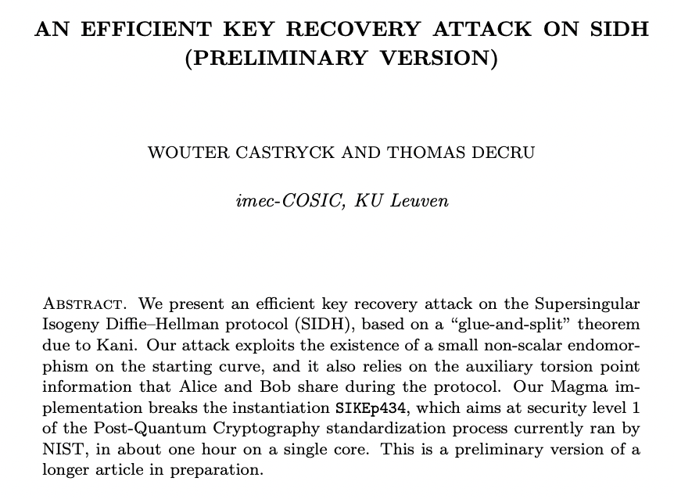
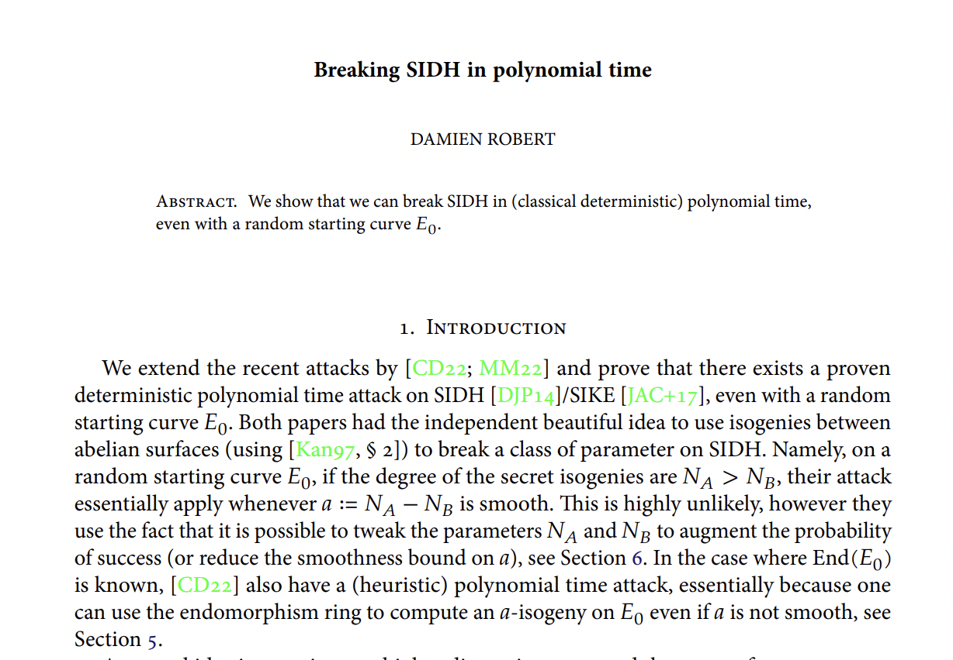
SIDH in the news
Notes:
[62]
There are two recent papers that have been in the news talking about attacks on SIDH; the first is by Castryck and Decru, called “An Efficient Key Recovery Attack on Sidh”, and the second is “Breaking SIDH in polynomial time”, by Robert and they literally came out at the beginning of summer of this year, so they are still relatively new.

Slide 63
Summary of paper (left)
Run on a single core, the appended Magma code breaks the Microsoft SIKE challenges $IKEp182 and $IKEp217 in about 4 minutes and 6 minutes respectively.
A run on the SIKE-434 parameters, previously believed to meet NIST’s quantum security level 1, took about 62 minutes, again on a single core.
Also ran code on random instances of SIKEp503 (level 2) and SIKEp610 (level 3) and SIKEp751 (level 5), which took about 2 hrs 19 min, 8 hr 15 min and 20h 37 min respectively.
Notes:
[63]
So the summary of the paper “An efficient key recovery attack on SIDH” is that run on a single core, they were able to break Microsoft SIKE challenges p182 and p217 in 4 and 6 minutes respectively.
A run on the SIKE434 parameters, previously believed to meet NIST’s quantum security level 1, took 62 minutes on a single core.
They also ran their code on rando instances on SIKEp503 (which is part of level 2 security) and SIKEp610 (level 3) and SIKEp751 (level 5) and they were able to break these challenges in 2 hours 19 minute, 8 hours 15 min and 20 hours 37 minutes respectively. So what does this mean for isogenies?

Slide 64
SIDH in the news
This attack is on SIDH, not CSIDH. Currently SIDH is broken but CSIDH is not. The Isogeny-based attacks on SIDH do not work for CSIDH.
That being said, instances of SIKE need to be fixed.
Notes:
[64]
It’s to be noted that this attack is on SIDH, not CSIDH and that currently SIDH is broken but CSIDH has not proven to be. The isogeny-based attacks on SIDH do not work for CSIDH. That being said, based on these attacks there are instances of SIKE that need to be fixed.

Slide 65
Composable Isogenies
Notes:
[65]
So going on to my project

Slide 66

Problem
Based on current methods, to generate a uniformly distributed supersingular curve, the person who generated the curve knows a path from to E.
Current solutions require a trusted party, but there is a lot of need (and interest) in finding ways that do not require a trusted party.
Notes:
[66]
A problem in isogenies protocols is that based on current methods, we need to generate a uniformly distributed supersingular curve, and so we need this trusted person who generates a curve that knows a path from E_0 to E.
So current solutions require a trusted party, but there is a lot of need (and interest) in finding ways that do not require a trusted party.

Slide 67
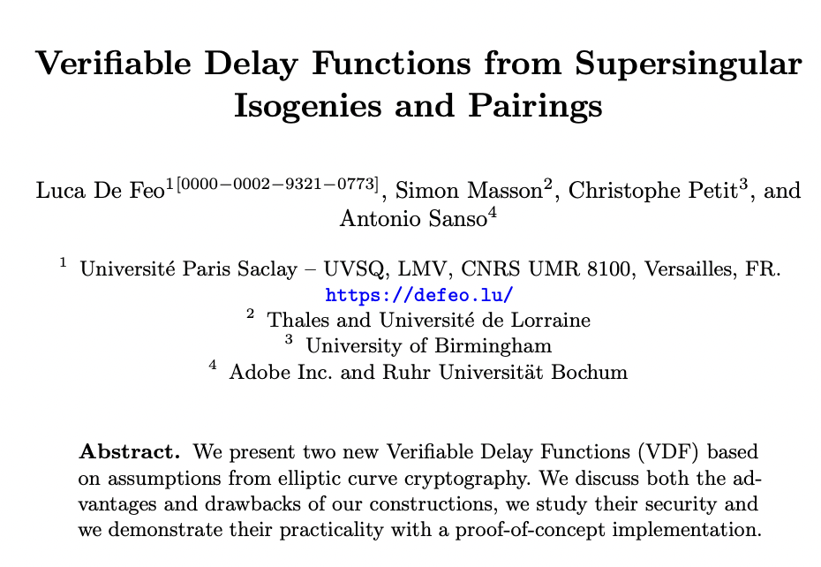
SIDH using a trusted setup and VDF
Notes:
[67]
In 2019, De Feo, Masson, Petit and Sanso proposed a Diffie Hellman key exchange solution using isogeny based cryptography, but the fact that it requires a secure and trusted setup is an obstacle to the VDF (Verifiable Delay Function) being usable in real life. We describe in detail in a proposal our two approaches, labelled A1 and A2 here in our distributed scalable setup.

Slide 68
Complexity of Project
Niche Skill Set: Hybrid of Computer Science, Pure Maths
Programming aspect: Build and Compare 2 Approaches to evaluate Tradeoffs between two systems
Evaluate Scalability: up to 1,000,000 distributed party network setup with usable time complexity generation and scalability
Build upon applications that may salvage the currently-broken hash function proposed by Charles, Goren and Lauter in 2006.
Notes:
[68]
This particular project is complex in that it requires a niche skillset of computer science and Pure Mathematics. It requires us to build two separate approaches and evaluate the tradeoffs between the two systems, to evaluate a 1,000,000 distributed party system with usable time complexity and scalability and to consider other applications such as salvaging the currently-broken hash function proposed by Charles, Goren and Lauter in 2006.

Slide 69
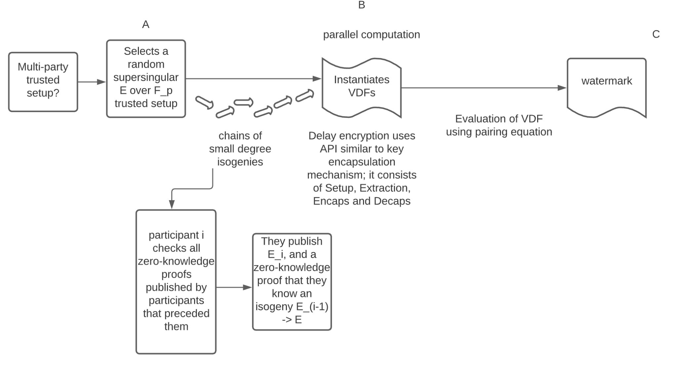
Impact and Innovation
A1a: We provide a multiparty computation setup so that we now have a trusted setup
A1b: We compute the random isogeny walk in a multiparty homomorphic encryption setup, allowing us to outsource this computation to a third party, therefore reducing time and computational complexity
A2: We use a zero-knowledge proof recursively via a recursive ZK-SNARK to reduce the cost complexity of verification from linear time O(n) to O(1)
Other applications, such as salvaging the currently-broken hash function proposed by Charles, Goren and Lauter in 2006.
A1a
A2, A1b
Notes:
[69]
Our Innovation, labelled in A1a and A1b and A2 are as such. In A1, we provide a multiparty computation system so that we now have a trusted setup that can be used with a VDF.
In A1b, we compute the random isogeny walk in a multiparty homomorphic encryption setup, allowing us to outsource this computation to a third party, therefore reducing time and computational complexity, and in A2, we use a zero-knowledge proof recursively via a recursive zk-snark, which reduces our time complexity from O(n) to O(1). Our solutions may have applications to other settings, such as salvaging the currently-broken hash function proposed by Charles, Goren and Lauter in 2006.

Slide 70
Approach I (encrypt)
Key generation done in multiparty protocol that returns the public key and one share of the secret key to each party
Each party creates random coins for random walk circuit and encrypts them
Parties send encrypted randomness and the starting point elliptic curve Eo to server
Notes:
[70]
For our first Approach ,we generate a key via a protocol that returns the public key and one share of the secret key to each party in our multiparty system. Then, we take the key of each party and create random coins for a random walk circuit and encrypt them. Then, the parties send the encrypted randomness and the starting point of the elliptic curve to the server.

Slide 71
Approach I (decrypt)
Server runs circuit in fully homomorphic encryption that computes encrypted the ith Elliptic Curve, using encrypted randomness
Parties decrypt the ith Elliptic Curve using the shared secret key
1234567
Notes:
[71]
On the server, the server runs the circuit in a fully homomorphic encryption that computes encrypted E^i, using encrypted randomness, and the parties can together, or within a specified threshold, decrypt E^i using the shared secret key.

Slide 72
Approach II
Uses proof-carrying data that provides proof of computation to the following node. Lowers time-complexity compared to original random walk by DeFeo et al.
This should reduce time complexity from O(n) to O(1), providing a zero-knowledge system for isogeny knowledge.
Notes:
[72]
Approach 2 uses the concept of proof carrying data, so that we provide the proof of computation to each following node in our system. This lowers the time complexity compared to the original random walk by De Feo et al from O(n) to O(1).

Slide 73
Approach II
Evaluate and build upon existing recursive Zero knowledge snarks such as Halo.
Dan Boneh, Justin Drake, Ben Fisch, Ariel Gabizon. “Halo Infinite: Recursive zk-snarks from any additive polynomial commitment scheme.” 2020
Notes:
[73]
In this approach, we plan to use recursive zero-knowledge snarks such as Halo.

Slide 74
Challenges and Limitations
(Recursive) ZK Snarks are still fairly new and evolving.
Information Theoretic constraints to verify secure computation.
Scalability of this distributed system is unknown.
Notes:
[74]
Some of our challenges have been that zk snarks are driven by blockchain technology, and as such, are still fairly new and evolving. Also, to ensure that our system is secure, we will have to measure information theoretic leaks in our system. Finally, the scalability of this distributed system is unknown.

Slide 75
Timeline
Notes:
[75]
So just to take a look at our current timeline…

Slide 76
Current Progress
Fall-Spring 2021-2022
Fall 2021
Fall 2022
Spring 2023
Summer 2023
Background
Proposal Plan
Approach I
Approach II
Evaluate
Honing of Background skillset (Secure Computation, Algebra I, III, post-quantum Mathematical Cryptography, Algebra IV, Elliptic Curves)
Proposal Written: Grant funding, review for feedback
Build Approach : multiparty FHE with server encryption and decryption
Build Approach II: usage of recursive ZK-Snark
Evaluate and Compare Approaches I and II. Use metrics to evaluate and write and submit paper to MathCrypt
Notes:
[76]
Here is my current progress. I’ve been, since Spring of 2021, learning the background needed to pursue this research, which involves learning Pure Mathematics and Mathematical Cryptography, as well as Secure Computation. In Fall 2021, we wrote a proposal based on our expectations of the project, and hope to begin Approach I in Fall of 2022, Approach II in Spring 2023 and our Evaluation in Summer 2023.

Slide 77
Conclusion
We went through the process of starting from elliptic curves, supersingular elliptic curves, isogenies and various components, as well as protocols. We spoke about some of the problems within isogenies and my project.
Problem is still unsolved, but exciting. The community is growing rapidly, but there are still a lot of interesting problems to solve and “low-hanging fruit” for people with mathematical cryptography backgrounds.
Notes:
[77]
So in conclusion, we went through the process of starting from elliptic curves, supersingular elliptic curves, isogenies and various components, as well as protocols, We spoke about some of the problems within isogenies and my project.
Isogenies research is an exciting area, with a lot of unsolved problems. The community is growing rapidly, but there are still a lot of interesting problems to solve and “low hanging fruit” for young researchers like myself to engage in, whether mathematically or computationally, or both.

Slide 78
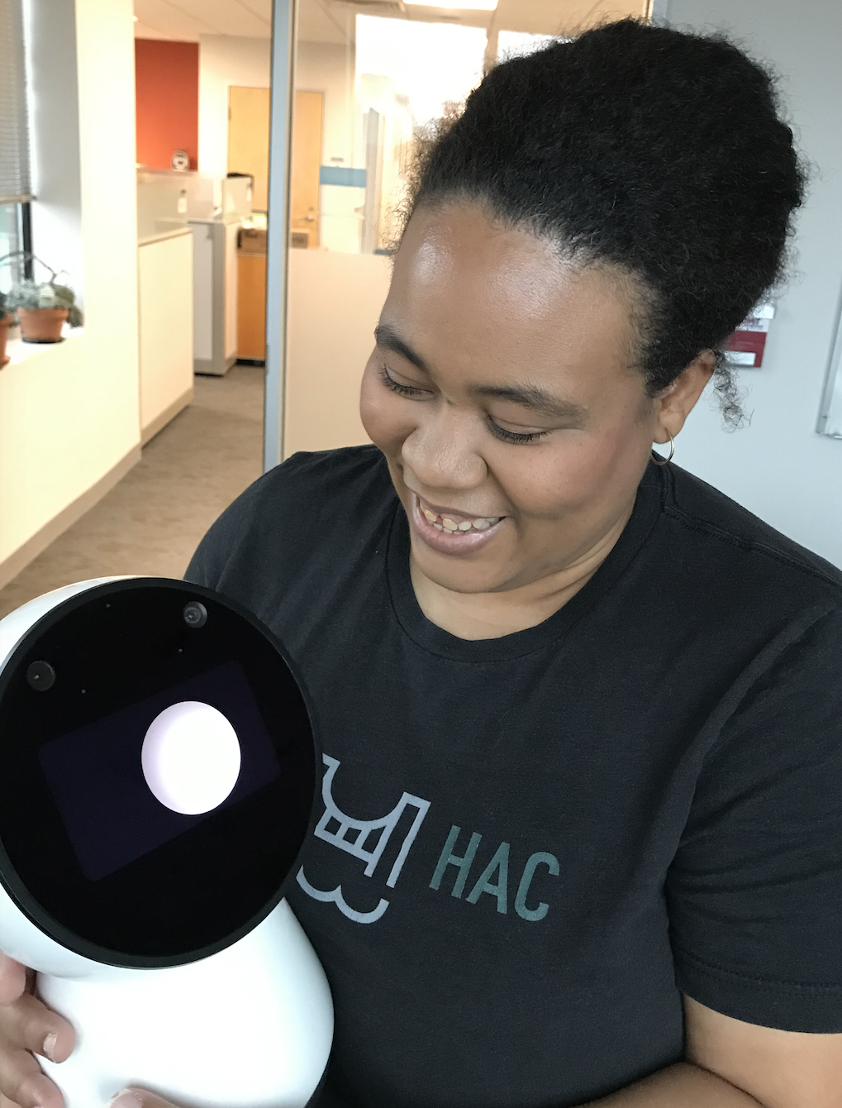
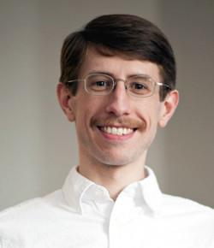
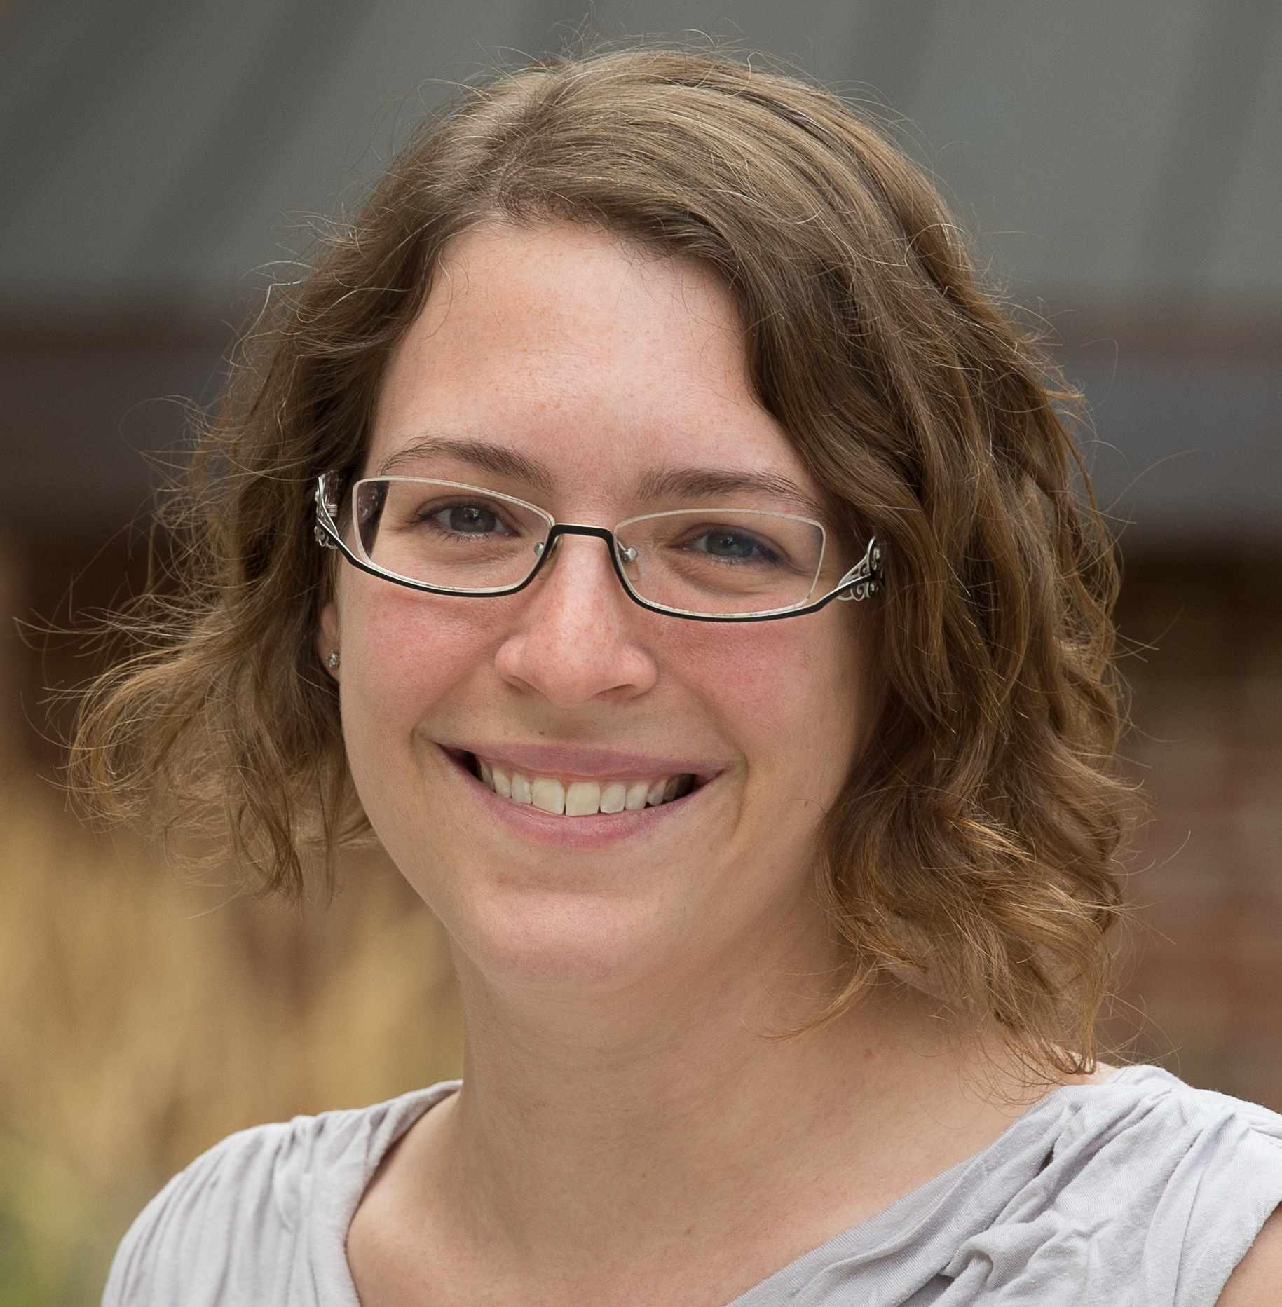
Thank you!
Advisors:
Joe Near, PhD, Christelle Vincent, PhD
Joe Near, PhD (UVM CS) Christelle Vincent, PhD (UVM Maths)
krystal.maughan@uvm.edu
Notes:
[78]
At this time, I’d like to thank my advisors; one in Computer Science, Joe Near, one in Pure Mathematics, Christelle Vincent, and my other research advisor, Puck Rombach, for continuing to support my foundation, knowledge and learning in this area. Thank you so much. I can also share the slides and leave a list of references I used while making this presentation.

Slide 79
References
Booher J. et al, 2022, “Failing to hash into supersingular isogeny graphs”
Bröker, R., 2013, “Constructing Supersingular Elliptic Curves”
Gaston G., 2017, “Hilbert Class Fields of Imaginary Quadratic Fields and Reflex Fields of Certain Sextic CM Fields”
Silverman J., 1986, “The Arithmetic of Elliptic Curves”
Nir Bitansky, Ran Canetti, Alessandro Chiesa and Eran Tromer, “Recursive composition and bootstrapping for snarks and proof-carrying data. 2013
Dan Boneh, Joseph Bonneau, Benedikt Bunz and Ben Fisch. “Verifiable Delay Functions”, 2018
Dan Boneh, Justin Drake, Ben Fisch, Ariel Gabizon. “Halo infinite: Recursive ZK-snarks from any additive polynomial commitment scheme., 2020
Sean Bowe, Jack Grigg, Daira Hopwood. “Recursive proof composition without a trusted setup.”, 2019
Eric Brier and Marc Joye, “Fast point multiplication on elliptic curves through isogenies, 2003
Jeffrey Burdges and Luca De Feo. “Delay Encryption, 2021
Denis X Charles, Kristin E. Lauter and Eyal. Goren. “Cryptographic hash functions from expander graphs”, 2009
Andrew Childs, David Jao and Vladimir Soukharev, “Constructing elliptic curve isogenies in quantum subexponential time”, 2014
Craig Costello “The case for sike: A decade of the supersingular isogeny problem.”, 2021
Craig Costello and Benjamin Smith, “The supersingular isogeny problem in genus 2 and beyond.”, 2019

Slide 80
References
Jean-Marc Couveignes, “Hard homogeneous spaces”, 2006
Luca De Feo. “Mathematics of isogeny based cryptography”, 2017
Luca De Feo, Simon Masson, Christophe Petit and Antonio Sanso, “Verifiable delay functions from supersingular isogenies and pairings”, 2019
Victoria de Quehen, Peter Kutas, Chris Leonardi, Chloe Martindale, Lorenz Panny, Christophe Petit and Katherine Stange, “Improved torsion point attacks on sidh variants”, 2020
Reynald Lercier and François Morain, “Computing isogenies between elliptic curves over F_p^n using couveignes’s algorithm, 2000
A. Lubotzky, R. Phillips, and P. Sarnak. “Ramanujan Graphs”, 1988
Tomoki Moriya, Hiroshi Onuki and Tsuyoshi Takagi. “Sigamal: A supersingular isogeny-based pke and its application to a prf”, 2020
Christian Mouchet, Juan Troncoso-Pastoriza, Jean-Philippe Bossuat and Jean-Pierre Hubaux, “Multiparty homomorphic encryption from ring-learning-with-errors”, 2020
Christophe Petit, Kristin Lauter and Jean-Jacques Quisquater, “Full cryptanalysis of lps and morgenstern hash functions”, 2008
Arnold K. Pizer, “Ramanujan graphs”, 1998
Siegel, J. “Elliptic Curve Encryption”, http://www.umsl.edu/~siegelj/information_theory/projects/EllipticCurveEncyiption.pdf

